Slide 1
Bath Soap Customer Segmentation
Nicholas Golina

Slide 2
Problem and Objective
CRISA is looking to revamp its marketing analytics by using customer segmentation to identify who is likely to purchase brands of products and what customers need to be reengaged.
The challenge is getting an informed overview of the customer base
Advertising and promotional campaigns can become more sophisticated in their targeting
Thus the objective is to identify the best group of customers based on brand loyalty and a history of high value purchases

Slide 3
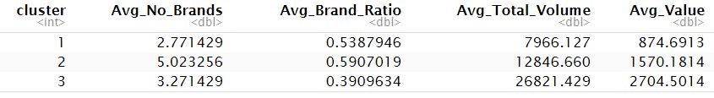
Modeling Strategy
Criteria for the target variable: value and volume of purchase, and ratio of consecutive purchases to total purchases
Despite the high number of brands purchased on average this showed that the customers are highly active

Slide 4
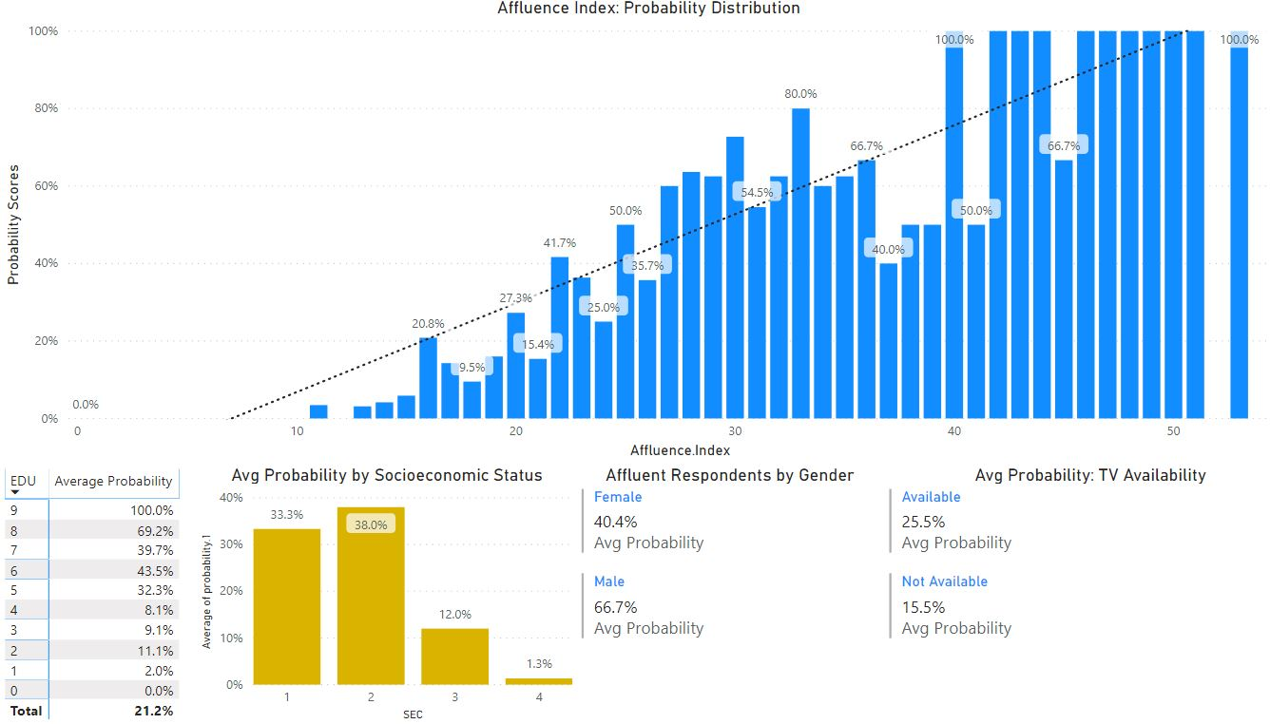
Insights and Recommendations
A holistic approach to marketing

